Slide 1




GASE - Introduction Subject: How to Study Author: Derek Somerville

Slide 2

Psych 1A: How to study
Submit – Toolset
Submit – Toolset
Submit – Toolset
Submit – Toolset
Submit – Toolset
Dr. Emily Nordmann (she/her)
Emily.Nordmann@glasgow.ac.uk
@emilynordmann

Slide 3

1st year of university

Slide 4
Quiz – Before Lecture
https://forms.office.com/Pages/ResponsePage.aspx?id=KVxybjp2UE-B8i4lTwEzyELpM2ZClsRNrJBn7A_b41VUODJUUURPSkZPNkYzMVFTNTNMTDFNVDdRSC4u

Slide 5
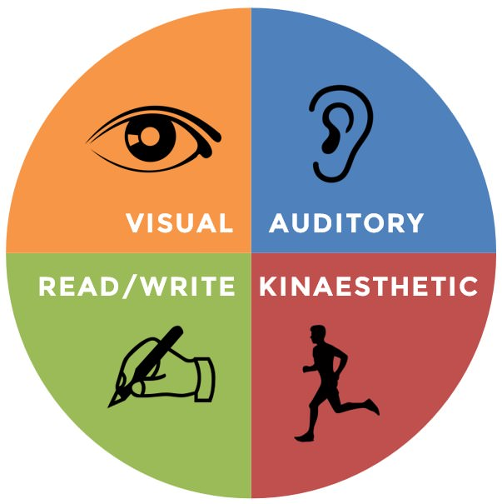
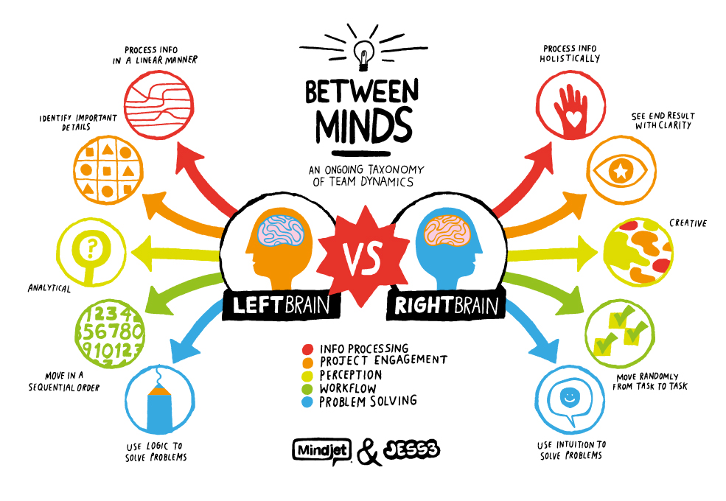
Learning styles
NO

Slide 6
Before lectures – Download Slides and Read
More efficient (and less effortful!) encoding during the lecture
Ensures less time taking notes that regurgitate the slides
Marsh and Sink (2010)

Slide 7
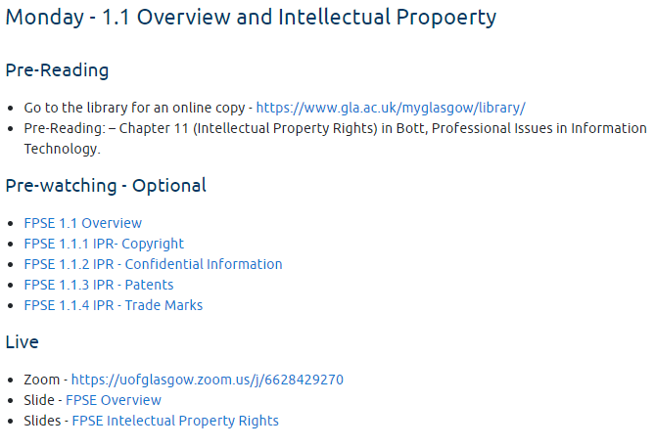
Before lectures – Essential Reading
There may also be further or recommended reading that gives additional detail
The main course textbook is available online via the library for free

Slide 8
During lectures: turn up/keep up
For face-to-face classes, attendance is a stronger predictor of final course grade than high school GPA, study habits and study skills (Crede et al., 2010)
But this applies to studying online as well!
If you can’t make the lecture, make sure you keep up with the recordings each week
You can’t binge the boxset and expect to do well!

Slide 9
During lectures: turn up/keep up
There are lots of legitimate reasons to miss live classes or occasional fall behind:
Physical and mental health problems
Caring responsibilities
Financial/commuting/time-zone issues
A global pandemic that took us all by surprise
Don’t miss classes you don’t have to, it will mitigate the impact of the ones you can’t avoid missing
Hold each other accountable & look after each other

Slide 10
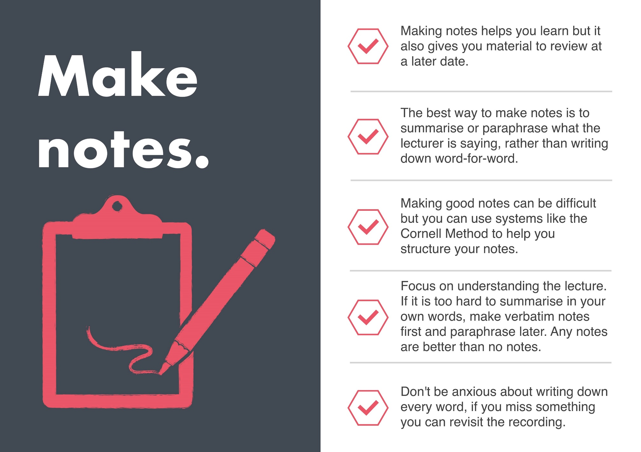
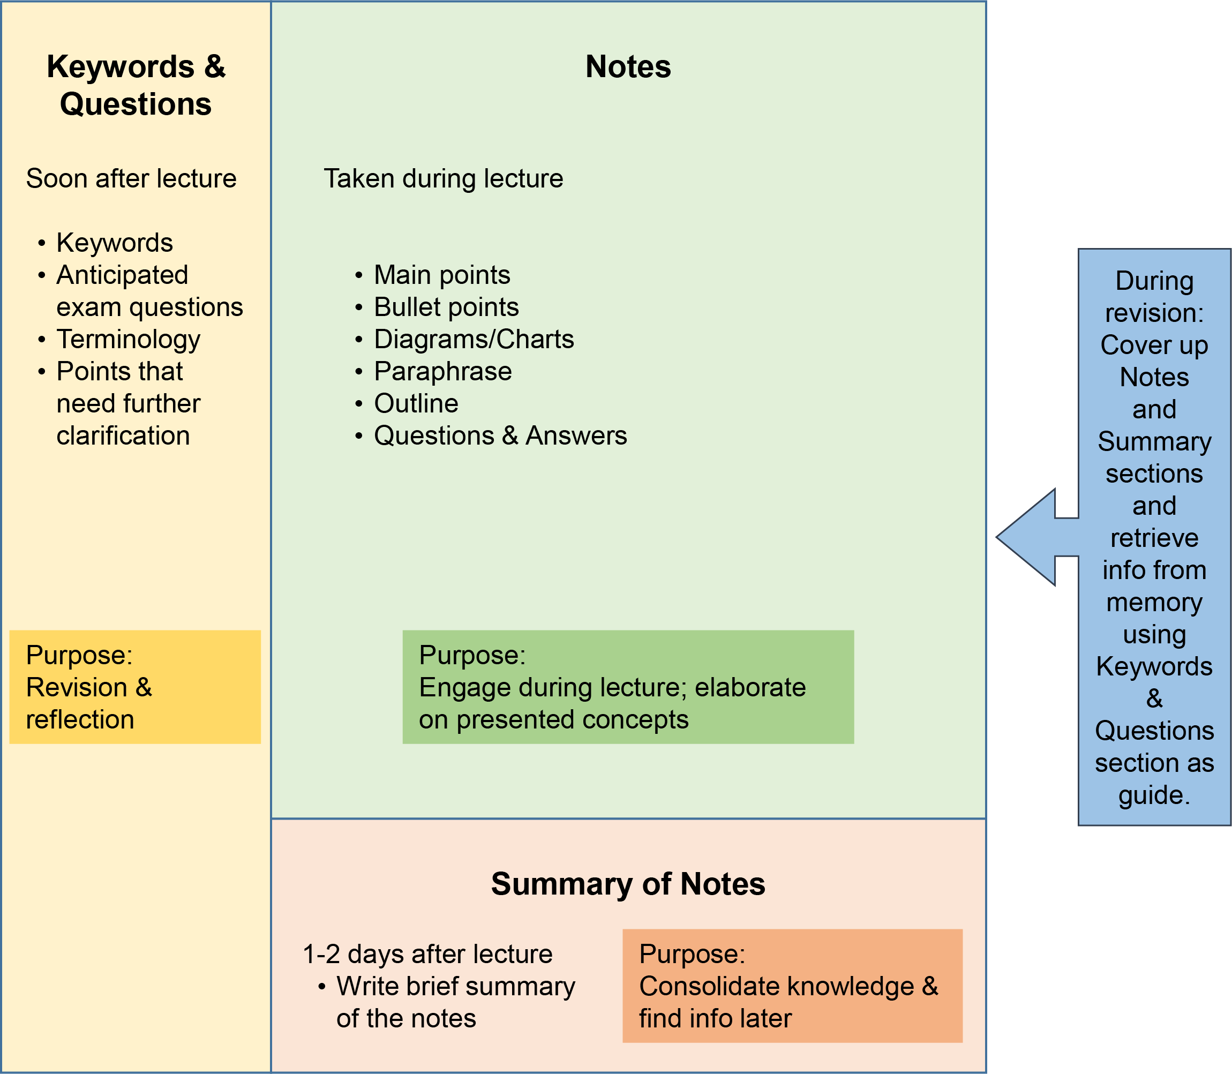
During lectures: take notes

Slide 11
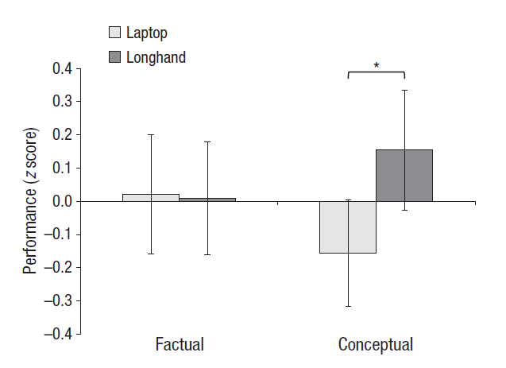
During lectures: take notes
Some evidence that taking notes by hand is better than using a laptop
Linked to deep processing and summarisation process
Mueller & Oppenheimer (2014)
But better evidence that the real problem is distraction (Sana et al. (2011)

Slide 12
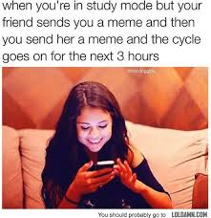
During lectures: focus
Review your notes – if you are transcribing word-for-word, consider switching to handwritten notes
Install an app that blocks access to social media etc. and switch it on when you’re studying
You can also get one for your phone – search for Social Media Blockers (I use Cold Turkey)

Slide 13
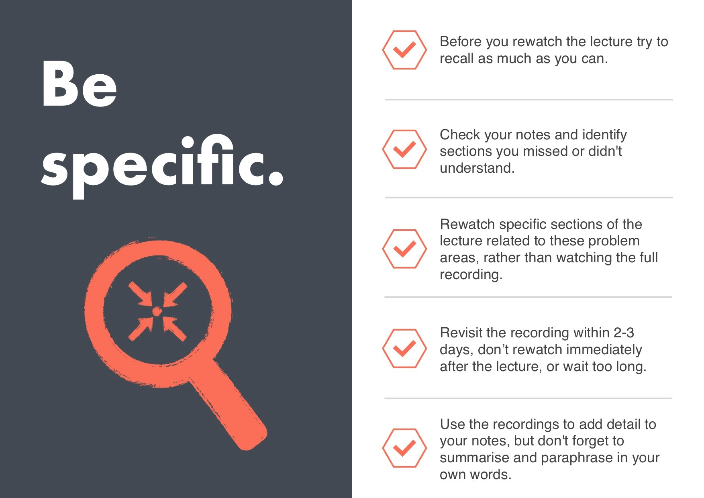
After lectures: review notes
Make sure your notes will make sense to you when you’re revising
Do any further or recommended reading and add information to your notes
Use the lecture recordings to revisit bits of the lecture you didn’t understand
Use the Cornell system (Pauk & Owens 2010, How to Study in College) to test yourself

Slide 14
End of Part 1

Slide 15
Part 2

Slide 16
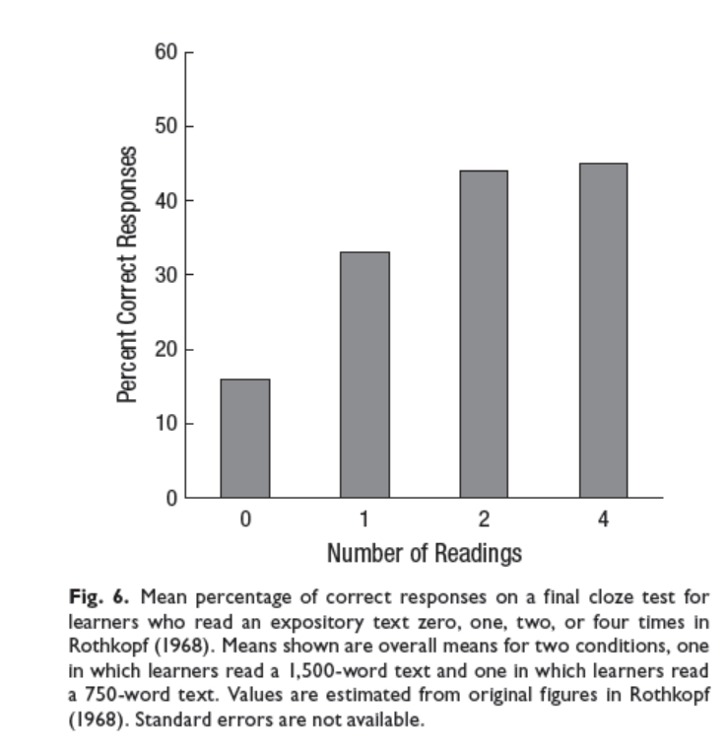
Reading vs. re-reading
Massed versus spaced reading
Spaced outperforms massed with moderate lags and delayed tests
Dunlosky et al. (2013)
Read each text once, twice if you need to revise specific sections and then do something more effective

Slide 17


Highlighting & underlining
Inverse relationship between amount of text highlighted and performance
Dunlosky et al. (2013)
Stick to the M&M rule: highlight meaningfully and minimally

Slide 18
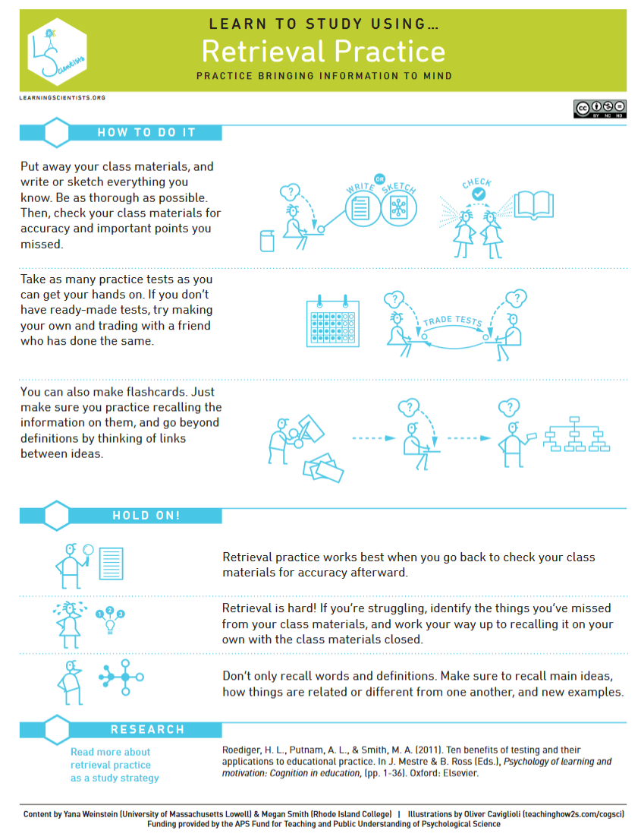
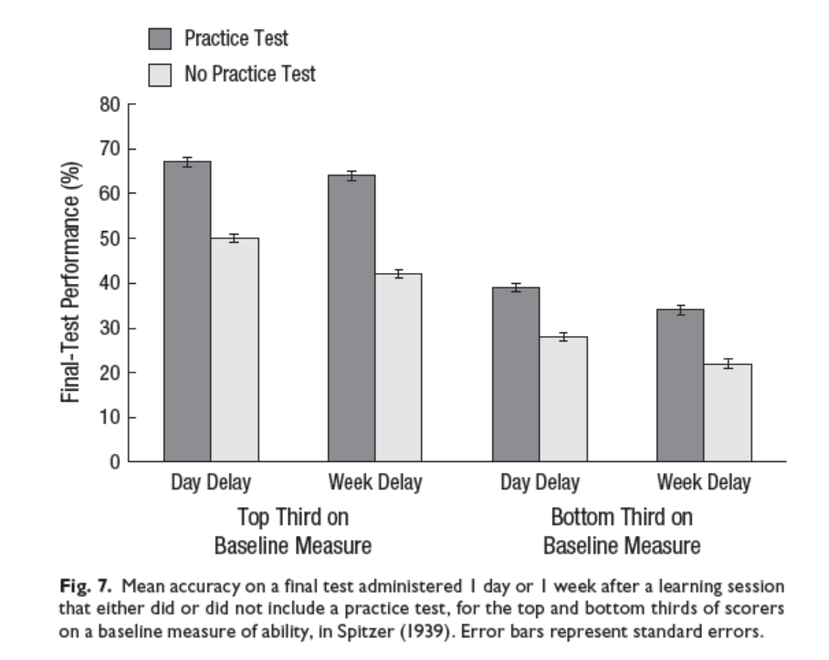
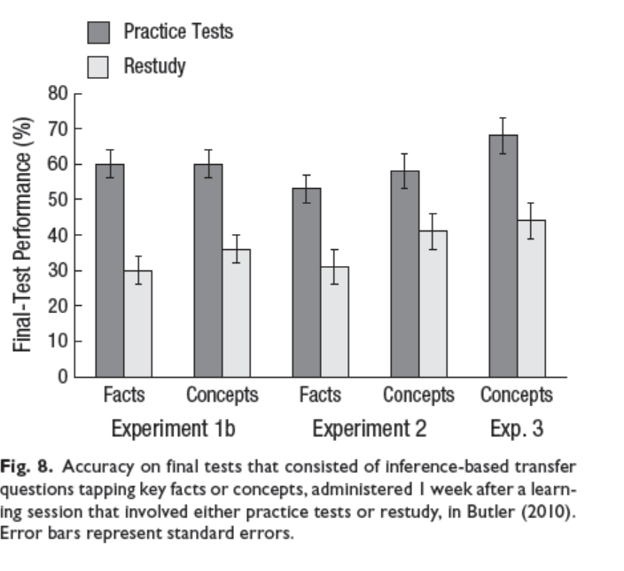
Retrieval practice
Retrieval practice = testing yourself
Dunlosky et al. (2013)

Slide 19
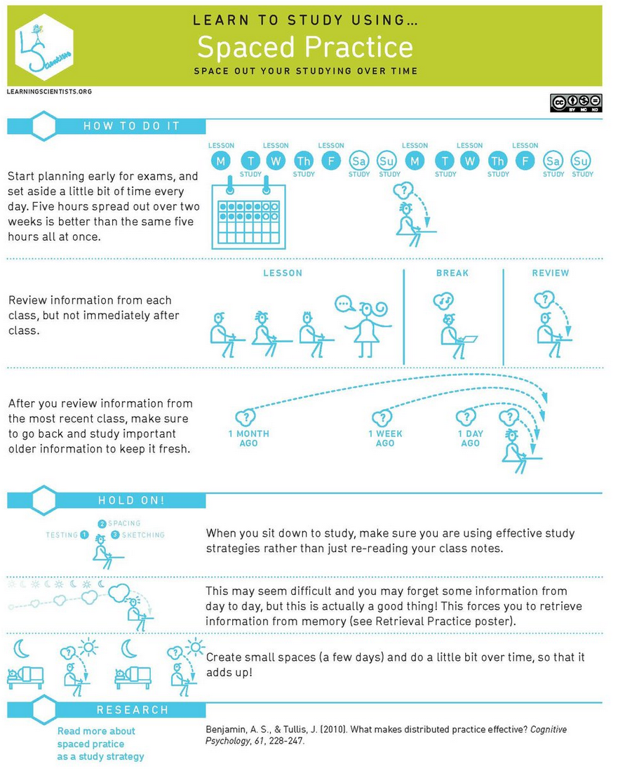
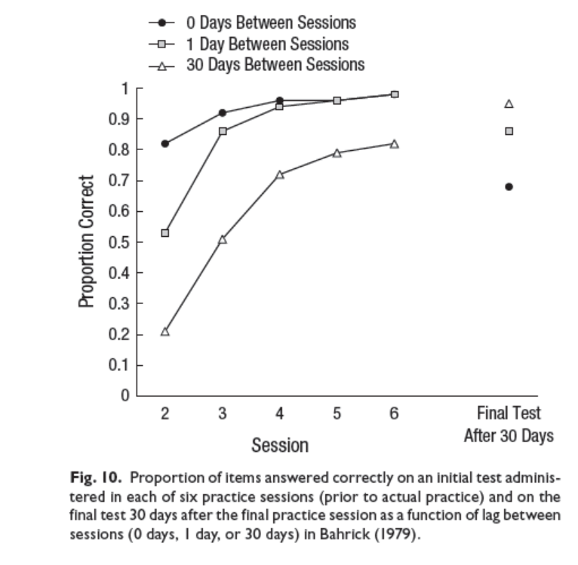
Distributed practice
Distributed practice = spread out your studying
E.g., Use lecture recordings throughout term
Cepeda et al. (2008)

Slide 20
End of Part 2

Slide 21
Part 3

Slide 22
Technology & environment
If you can, find a quiet space to work that isn’t your bedroom
If you can, talk to the people you live with about when you will need e.g., access to the internet or a quiet environment
To save on data, download all the materials/videos you can when you’re connected to Wi-Fi, rather than always needing to be on online to access them
If you do not have reliable access to the internet, a laptop, and/or a quiet space to study, please get in touch, we can help

Slide 23
Assessment & feedback
Each course and assessment has Intended Learning Outcomes
Meet these outcomes = get a good grade
Check the Assessment Information Sheet and Feedback Information Sheet for each assignment
Lecture ILOs = exam questions
We are not trying to trick you
Review previous feedback before starting your next assignment

Slide 24
Open-book exams
We will have a specific exam session nearer the time & more information on Moodle
24-hour exam
But you are only expected to spend the usual (2 hours) time on it!
The extra time is for flexibility
“There is no knowledge on the internet, only information”
You still have to study
Keep organised notes based on the ILOs

Slide 25
Managing your time
You will have scheduled lectures & tutorials but a lot of your time will be spent on independent study
As a rough guide, you should be studying for 10-15 hours a week for each of your three courses (inclusive of timetabled and independent study)
Use the Moodle checklists and schedule a time to work on each task
It is important to develop a routine. You will be happier, less stressed, and do better if you make a full timetable and stick to it

Slide 26
Help & support
Learning Enhancement & Academic Development Service (LEADS)
https://www.gla.ac.uk/myglasgow/leads/students/
Blended Learning & Assessment Moodle
https://moodle.gla.ac.uk/course/view.php?id=19209
Making the Most of Lectures Moodle
https://moodle.gla.ac.uk/course/view.php?id=18848
Let us know what we’re doing well and what we could improve on the Q&A

Slide 27
Help & support
Counselling & Psychological Services
https://www.gla.ac.uk/myglasgow/counselling/
Disability Service
https://www.gla.ac.uk/myglasgow/disability/
If you have (or think you may have) additional needs such as dyslexia that give you provisions such as extra time, register with the disability service ASAP.
Advisor of Studies
Course Lead
Student office hours
Ask questions about lecture content
Get additional support for assessments and/or interpreting and understanding feedback
If you want to talk to someone about any problems you might be facing
General chat/borrow a book/talk about Drag Race*
Check office hours here https://www.gla.ac.uk/schools/psychology/staff/
*certain staff only

Slide 28
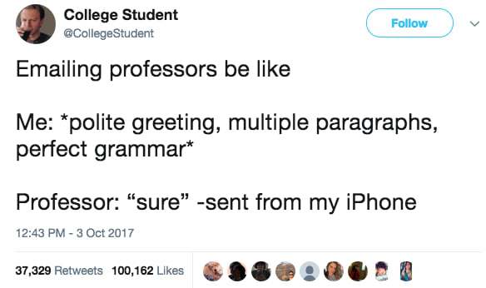
How to send a private Teams message/e-mail
In psychology, we’d like you to use Teams to communicate with staff, your other subjects may want you to use e-mail
If you’re using e-mail, use your @glasgow.ac.uk account
Include the specific course code you’re getting in touch about
Make an effort to contact the right person and check that the answer to your question isn’t already available (e.g., in the course handbook)
Give us as much info as you can (e.g., if you’re having problems with Moodle tell us what solutions you’ve already tried)
Most of your lecturers will have an academic title, e.g., Dr. Nordmann or Prof. Stack. Some may be ok with using their first name, some may wish you to be more formal – when in doubt go with Prof. (you’re unlikely to annoy someone with a promotion)
You may call me Emily or Dr. Nordmann. Please do not call me Mrs/Ms/Miss Nordmann.

Slide 29

Useful software and apps
OneDrive – don’t let the digital dog eat your homework, backup EVERYTHING
OneNote – organise and sync all your notes in one place
Office365 – In addition to OneDrive & OneNote you get access to all of Microsoft Office (Word, Excel, Powerpoint etc. for free)
ColdTurkey – Social media blocker
Outlook calendar (or any other calendar, just use a calendar)
Grammerly – spelling and grammar checking
GoConqr – create flashcards and quizzes for testing yourself
Other apps are available! You don’t need to use these exact ones but find something with similar functionality.

Slide 30

References
You don’t need to read all these – they’re here so that if you found something particularly interesting you can look up the original study (you’re going to learn how to search for journal articles in Week 1).
Bos, N., Groeneveld, C., van Bruggen, J., & Brand-Gruwel, S. (2016) The use of recorded lectures in education and the impact on lecture attendance and exam performance. British Journal of Educational Technology, 47(5), 906–917 doi:10.1111/bjet.12300
Cepeda, N. J., Vul, E., Rohrer, D., Wixted, J. T., & Pashler, H. (2008). Spacing effects in learning a temporal ridgeline of optimal retention. Psychological science, 19(11), 1095-1102. http://files.eric.ed.gov/fulltext/ED505660.pdf
Dunlosky, J., Rawson, K. A., Marsh, E. J., Nathan, M. J., & Willingham, D. T. (2013). Improving students’ learning with effective learning techniques: Promising directions from cognitive and educational psychology. Psychological Science in the Public Interest, 14(1), 4-58.
Marsh, E. J., & Sink, H. E. (2010). Access to handouts of presentation slides during lecture: Consequences for learning. Applied Cognitive Psychology, 24(5), 691-706.
Mueller, P. A., & Oppenheimer, D. M. (2014). The pen is mightier than the keyboard: Advantages of longhand over laptop note taking. Psychological science, 25(6), 1159-1168.
Nordmann, E., Calder, C., Bishop, P., Irwin, A., & Comber, D. (2019). Turn up, tune in, don’t drop out: The relationship between lecture attendance, use of lecture recordings, and achievement at different levels of study. Higher Education, 77(6), 1065-1084.
Nordmann, E., Kuepper-Tetzel, C. E., Robson, L., Phillipson, S., Lipan, G., & Mcgeorge, P. (2018, December 11). Lecture capture: Practical recommendations for students and instructors. https://doi.org/10.31234/osf.io/sd7u4
Patterson, R. W., & Patterson, R. M. (2017). Computers and productivity: Evidence from laptop use in the college classroom. Economics of Education Review, 57, 66-79.
Putnam, A. L., Sungkhasettee, V. W., & Roediger III, H. L. (2016). Optimizing learning in college: tips from cognitive psychology. Perspectives on Psychological Science, 11(5), 652-660.

